Slide 1

Periodontitis Risk Prediction: ML Classification Pipeline
A machine learning pipeline for early detection using NHANES clinical indicators

Slide 2
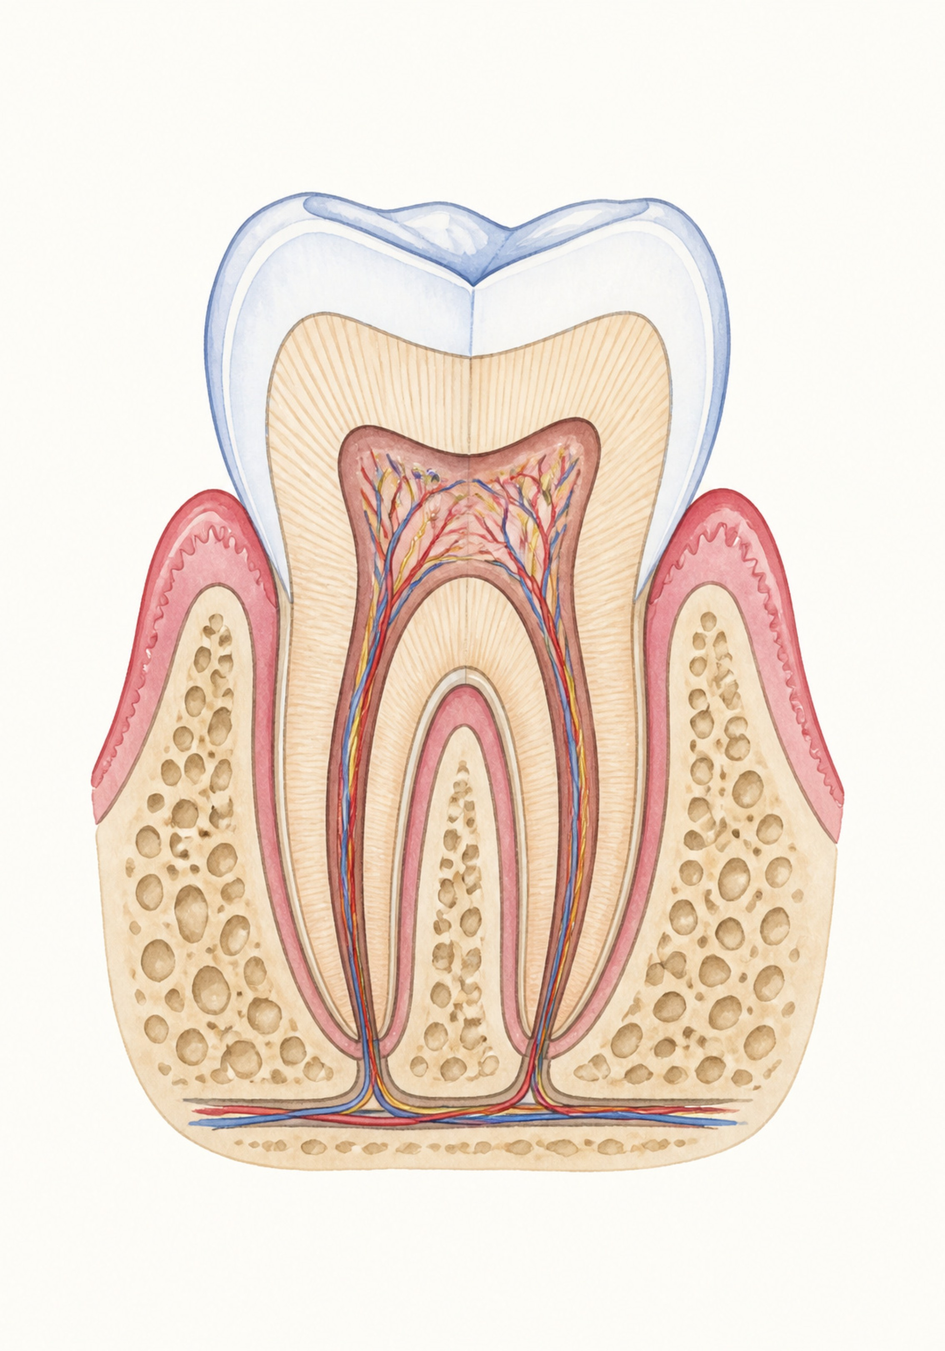
The Clinical Challenge
47% of US Adults
Early Detection
Periodontitis prevalence in the United States — a widespread yet underdiagnosed condition (CDC data)
Prevents tooth loss and systemic complications including cardiovascular and diabetic risks
NHANES Indicators
Goal: Build a predictive model using non-invasive, nationally representative survey features

Slide 3
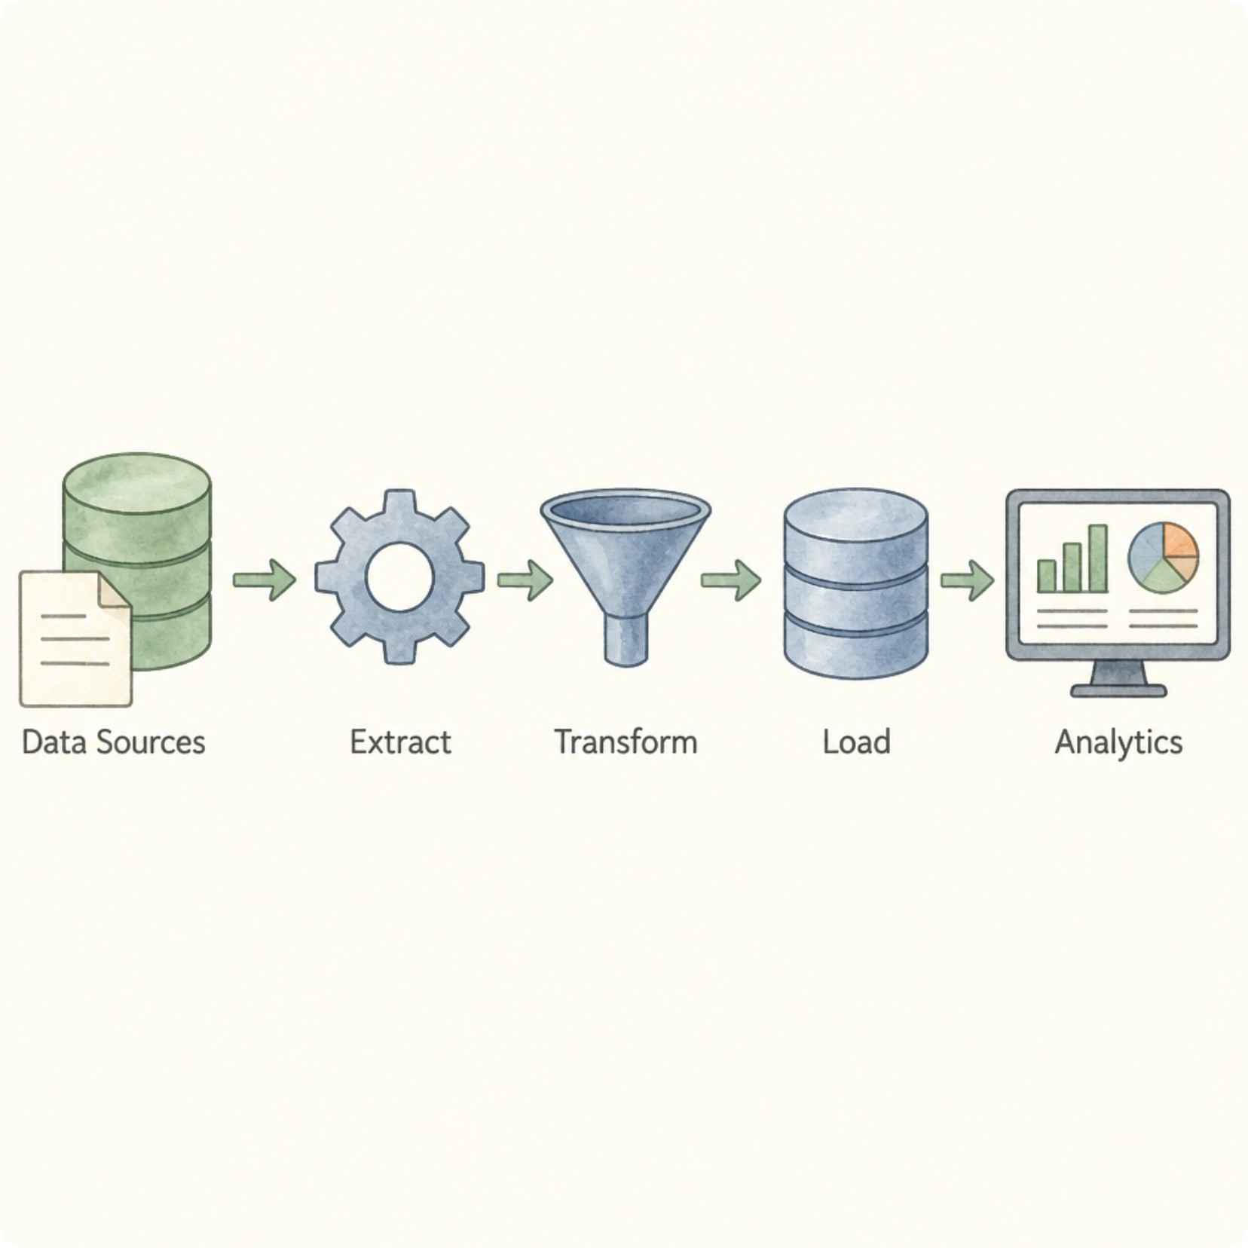
Data Pipeline: Preprocessing & Feature Engineering
Data Cleaning
Removed administrative noise and eliminated target leakage risks to ensure data integrity.
Feature Selection
Dropped high-missingness features (>50%) and applied VarianceThreshold to prevent rank deficiency.
Scaling
Standardized numerical predictors for distance-sensitive algorithms using z-score normalization.

Slide 4



Modeling Strategy
Logistic Regression
Gradient Boosting
Random Forest
Linear baseline — interpretable and efficient for binary classification
Sequential ensemble — learns from prior errors to reduce bias
Bagging ensemble — decorrelated trees capture complex feature interactions
All models evaluated on a stratified 80/20 train-test split preserving class balance. Metrics: Accuracy, Precision, Recall, F1-Score, and ROC-AUC.

Slide 5
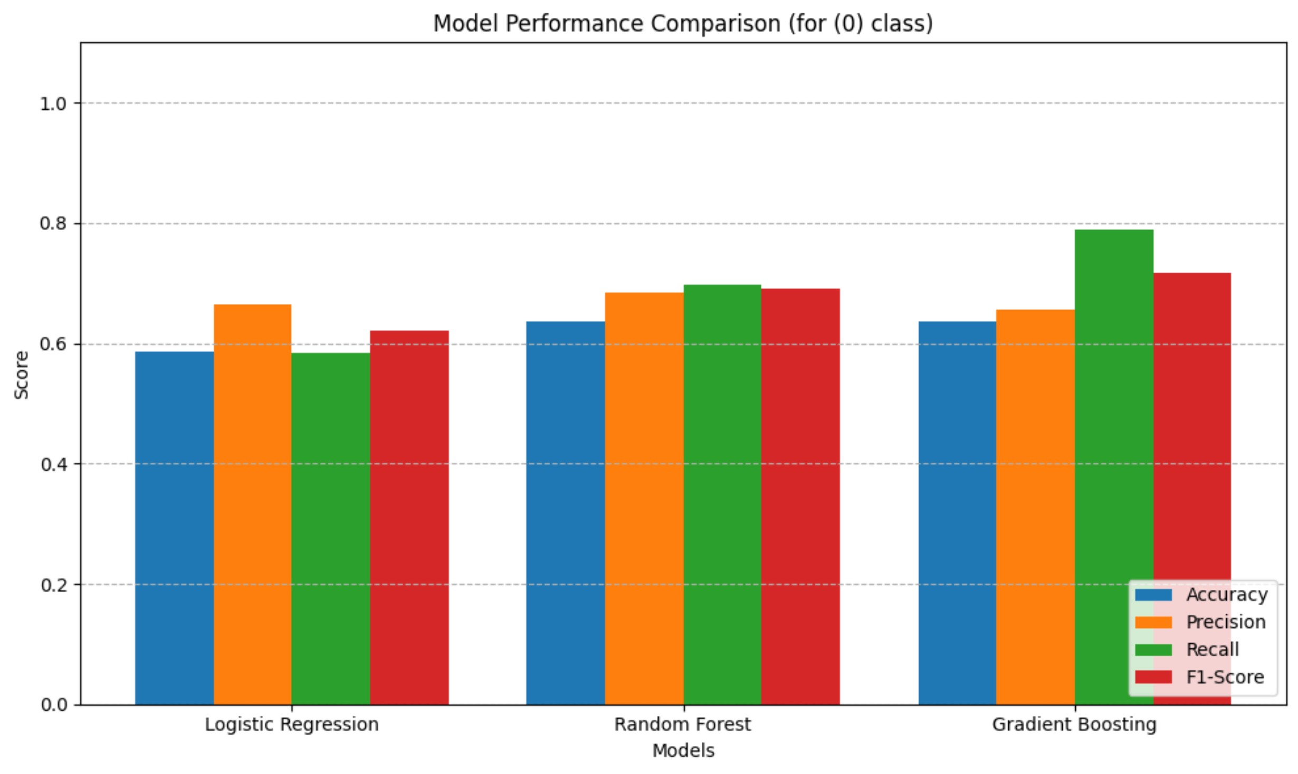
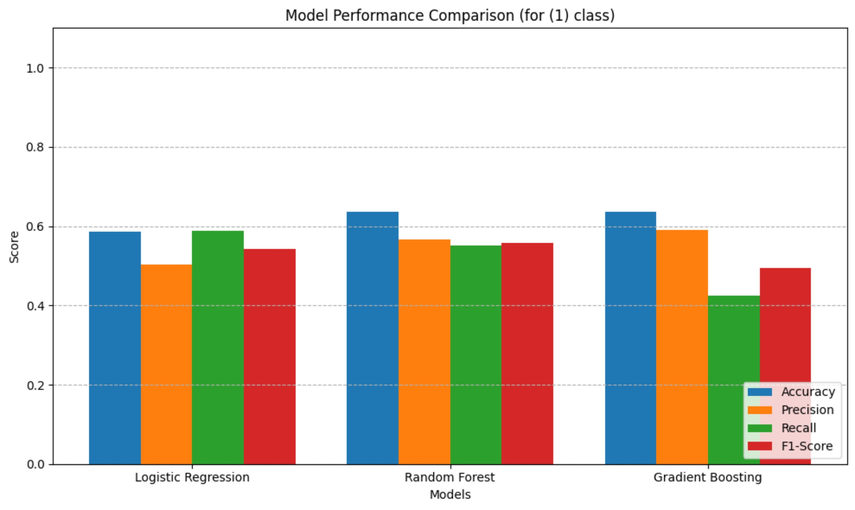
Model Performance Comparison

Slide 6

Why Random Forest Won
Highest Precision — 0.68
Balanced Recall — 0.70 (Class 0) / 0.55 (Class 1)
Ensemble Strength
Bagging decorrelated trees captures complex, non-linear feature interactions invisible to a linear baseline.
Minimizes false positives in clinical screening, reducing unnecessary patient burden and follow-up costs.
Captures true positives without overfitting to the majority class — essential for clinical equity.

Slide 7
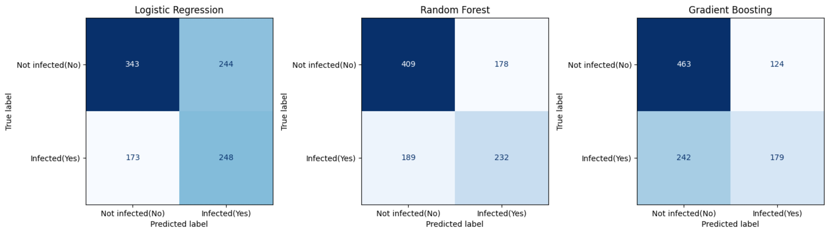

Confusion Matrices: Model Predictions
Reading the Results
Random Forest achieves the best balance across all four prediction quadrants:
409 True Negatives — correctly dismissed healthy cases
232 True Positives — correctly flagged at-risk patients
178 False Positives — manageable over-referrals
189 False Negatives — lowest missed diagnoses
In clinical screening, minimizing false negatives is paramount — missed diagnoses carry the highest patient risk.

Slide 8




Clinical Utility & Deployment
Balanced Screening
Random Forest balances sensitivity (recall) and specificity (precision) — the gold standard for real-world clinical screening tools.
Streamlit Interface
Model is ready for integration into a Streamlit health risk assessment interface for clinician-facing use.
Actionable Risk Scores
Outputs interpretable probability scores to support clinical decision-making without replacing clinician judgment.

Slide 9
Key Takeaways
1
Reproducible Pipeline
2
Random Forest Outperforms
3
Clinically Deployable
Systematic approach from data cleaning through model selection ensures reproducibility and academic rigor.
Model achieves balanced performance across both classes — ready for integration into real-world screening workflows.
Ensemble bagging captured non-linear feature interactions that linear and sequential baselines could not model.

Slide 10
Final Output Repo
GitHub Repository
All code, data preprocessing scripts, model training notebooks, and evaluation outputs are available at:
https://github.com/belal122333444455555-ui/NTI-Capstone-Project

